Slide 1



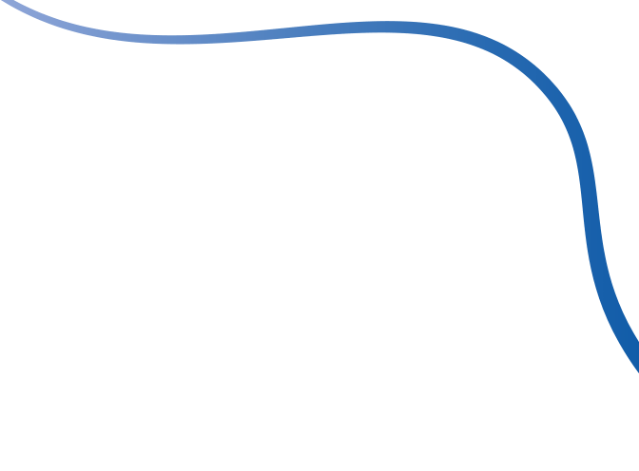



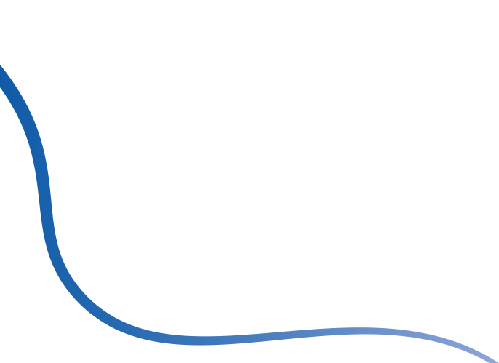

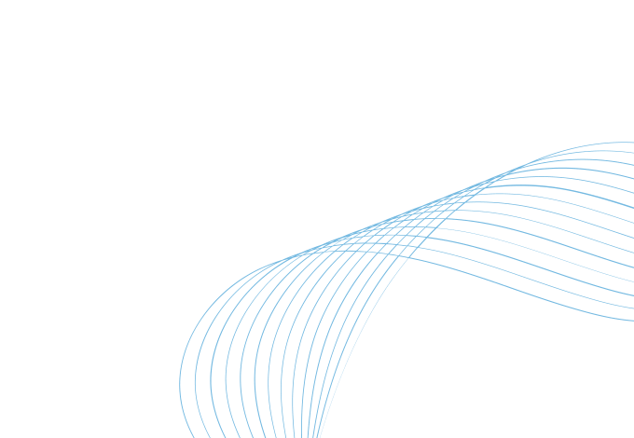

DIGITAL PORTFOLIO
STUDENT NAME: P.Priyadharshini
REGISTER NO AND NMID: 212401640 & 8952767E0C2DBB584E24DA0216916764
DEPARTMENT: BCA
COLLEGE/UNIVERSITY: Thirumurugan arts and science college for women/Madras
University

Slide 2
PROJECT TITLE
EXPLORING MY SKILLS AND TALENTS
PORTFOLIO

Slide 3
AGENDA
1.Problem Statement
2.Project Overview
3.End Users
4.Tools and Technologies
5.Portfolio Design and Layout
6.Features and Functionality
7.Results and Screenshots
8.Conclusion
9.Github Link

Slide 4
PROBLEM STATEMENT
Many students struggle to effectively showcase their skills, projects, and talents using traditional
resumes or printed documents. This limits their ability to stand out when applying for internships,
scholarships, or higher studies. To solve this, I created a personal digital portfolio using HTML, CSS, and
JavaScript. It provides a modern, interactive platform to present my work, achievements, and contact
details—helping me share my capabilities in a more professional and accessible way.

Slide 5
PROJECT OVERVIEW
This Student Digital Portfolio is a personal website built using HTML, CSS, and JavaScript to showcase my
skills, projects, and achievements. It includes sections like About Me, Skills, Projects, and Contact, all
designed with a clean, responsive layout. The site allows me to present my work in a professional, interactive
way and acts as an online resume for internships, college applications, or job opportunities. It also serves as a
practical example of my web development skills.

Slide 6
WHO ARE THE END USERS?
The end users of this portfolio include teachers, recruiters, college admission
officers, project evaluators, and potential collaborators who want to learn more
about my skills and achievements. It can also be useful for peers and mentors
looking to understand my work, give feedback, or collaborate on future projects.

Slide 7
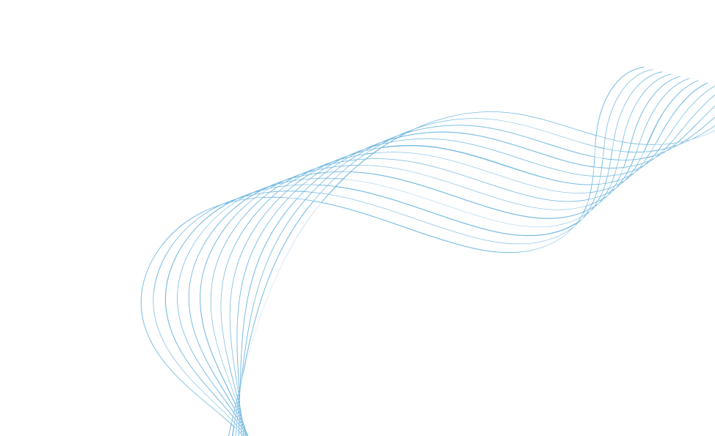
TOOLS AND TECHNIQUES
The Student Digital Portfolio was developed using HTML, CSS, and JavaScript. HTML was
used to create the structure and content of the website, such as headings, paragraphs.
CSS was used to style the website, including layout, colors, fonts, and responsiveness.
JavaScript added interactivity, such as form validation.The project can be deployed using
tools like GitHub Pages.

Slide 8
PORTFOLIO DESIGN AND LAYOUT
The portfolio has a clean and simple design with a top navigation bar for easy access to each
section like About Me, Skills, Projects, and Contact. Each section is well-organized and easy to
read, using a scrollable layout. CSS is used for styling, with Flexbox and media queries to make
the site responsive on both phones and computers. The colors, fonts, and spacing are chosen to
keep the design neat, professional, and user-friendly.

Slide 9
FEATURES AND FUNCTIONALITY
Mobile-friendly, responsive design
Simple top navigation menu
Sections: About Me, Skills, Projects, Contact
Clean and professional layout
Contact form with basic validation
Interactive feedback using JavaScript
Easy to update with new content
Can be hosted online (e.g., GitHub Pages)

Slide 10
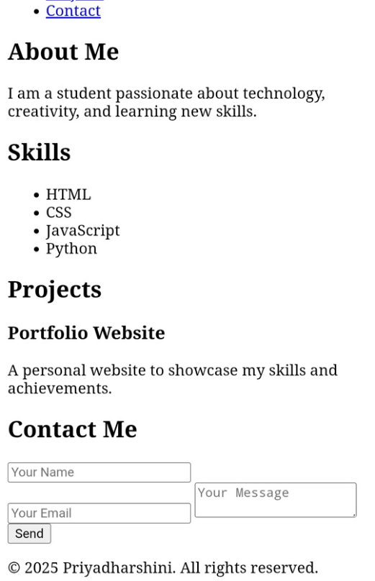
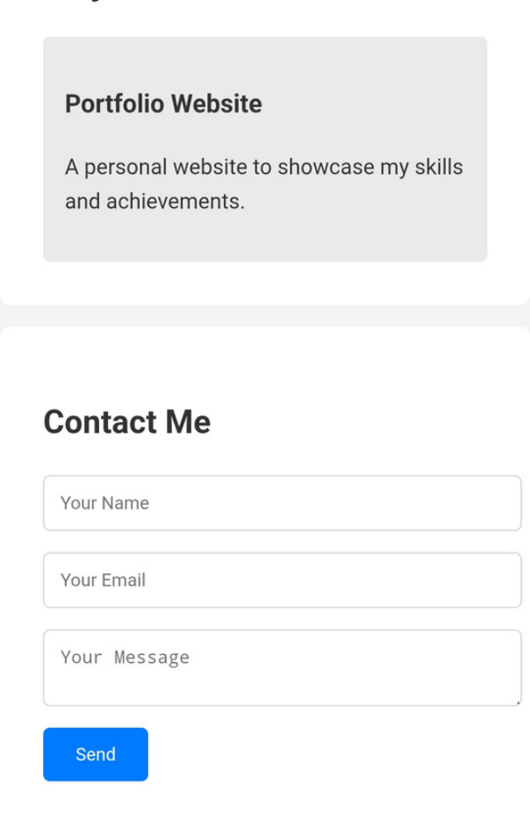
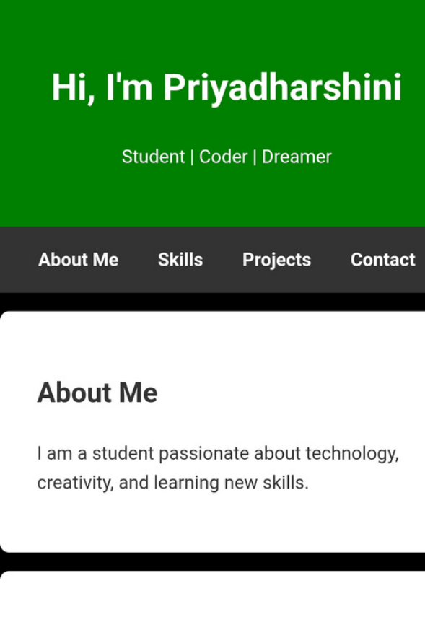
RESULTS AND SCREENSHOTS

Slide 11
CONCLUSION
Highlights of my project:This portfolio is a responsive website made with HTML, CSS, and JavaScript. It
highlights my skills and projects, includes a contact form, and works well on all devices. It can be shared
online as a digital resume.
Final summary:A responsive personal portfolio built using HTML, CSS, and JavaScript.Showcases my skills,
projects, and achievements in a clean layout.Useful as a digital resume for internships, jobs, or academics.
Befits to society:This portfolio encourages digital skills, helps students present themselves professionally,
and improves access to opportunities. It supports a more skilled and tech-aware society.

